Slide 1

IST 718
Group Project Proposal
Life Expectancy
Nick McFadden
Sahil Nanavaty
Phuong (Adrianne) Van
Cole Wood
Soham Nanavati

Slide 2
Business Questions
What are the top three factors of life expectancy? Any other major factors?
Does life expectancy have a positive or negative relationship with the various factors (eating habits, population, exercise, health, etc)
Should a country having a lower life expectancy value(<65) increase its healthcare expenditure in order to improve its average lifespan?

Slide 3
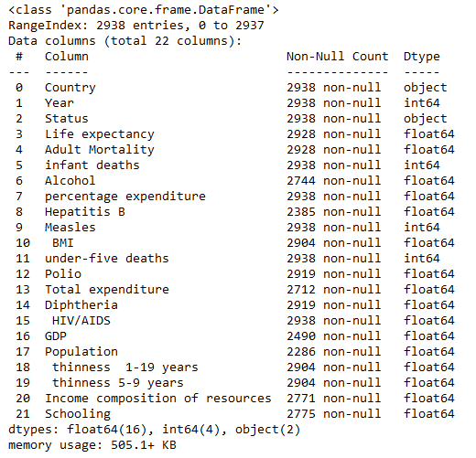




About the Data
Global life expectancy data set from 2000-2015 (22 columns and 2,938 rows)
Data comes from the World Health Organization (WHO)
Contains over 193 countries
Merge in nutritional deficiencies data from WHO Mortality Database
Kaggle: https://www.kaggle.com/datasets/kumarajarshi/life-expectancy-who
WHO: https://platform.who.int/mortality/themes/theme-details/topics/topic-details/MDB/nutritional-deficiencies

Slide 4




Team Roles & General Tasks
The process of modifying and correcting data for consistency and for removing incomplete and irrelevant data
Develop visualizations and communicate results
EDA
Clean-up
Analysis
Conclusion
Complete Exploratory Data Analysis by performing initial investigations of data and summarizing general characteristics
Will be completing descriptive and predictive analyses by using Regression, Classification, etc.
All team members will be performing all tasks (analysis tasks will be split among members)

Slide 5

THANK YOU!

